Slide 1
Regression and essential concepts

Slide 2
Introduction
Statistical measurement to determine the strength of the relationship between one dependent variable (usually denoted by Y) and a series of other changing variables (known as independent variables).
Linear regression: Y = a + bX + u
Y = the variable that you are trying to predict (dependent variable).
X = the variable that you are using to predict Y (independent variable).
a = the intercept.
b = the slope.
Notes:
https://www.investopedia.com/terms/r/regression.asp

Slide 3
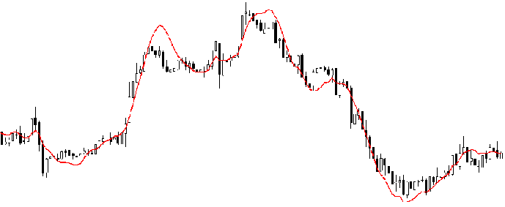
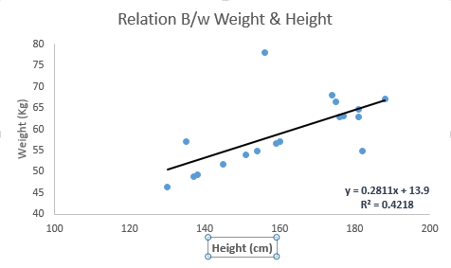
What is Regression Analysis?
Investigates the relationship between a dependent (target) and independent variable (s) (predictor).
This technique is used for forecasting and finding the causal effect relationship between the variables.
For example, relationship between rash driving and number of road accidents by a driver is best studied through regression.

Slide 4
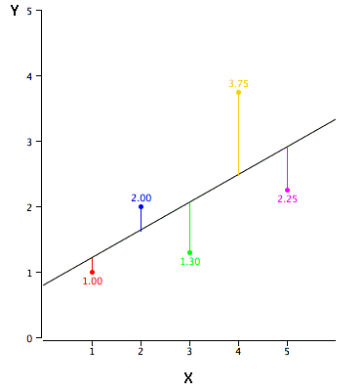

How to obtain best fit line (Value of a and b)?
Easily accomplished by Least Square Method.
Most common method used for fitting a regression line.
Calculates the best-fit line for the observed data by minimizing the sum of the squares.

Slide 5
Applet
Refer to below URL for a live example:
http://www.rossmanchance.com/applets/RegShuffle.htm

Slide 6
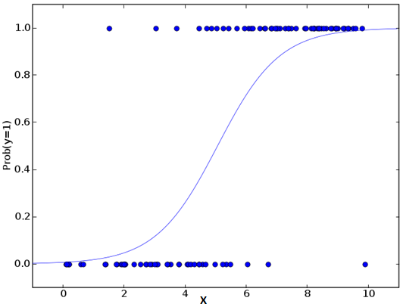
Logistic Regression
To find the probability of event=Success and event=Failure.
We should use logistic regression when the dependent variable is binary (0/ 1, True/ False, Yes/ No) in nature.

Slide 7
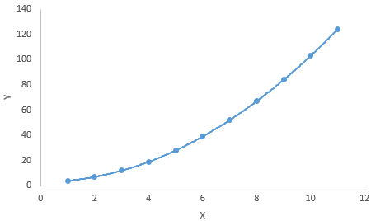
Polynomial Regression
A regression equation is a polynomial regression equation if the power of independent variable is more than 1. The equation below represents a polynomial equation:
y=a+b*x^2
In this regression technique, the best fit line is not a straight line. It is rather a curve that fits into the data points.

Slide 8
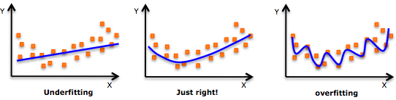
Important Points

Slide 9
Thanks

